Slide 1
Level 3 Python
Week 5 - Planning

Slide 2
What have we learned so far?
Tkinter to create a GUI
Using the mouse with the GUI
Creating an advanced GUI (calculator)
Classes and objects
Assessment – project based
Notes:
So far we have learned about tkinter to create a GUI, using the mouse with the GUI, creating an advanced GUI, classes, and objects.
We also discussed the assessment which is project based.

Slide 3
Program planning
Included in Level 2 and 3
Flowchart
Variable table
Testing table
New at Level 3
Design sketch
Notes:
So far we have learned about tkinter to create a GUI, using the mouse with the GUI, creating an advanced GUI, classes, and objects.
There are four major areas you must complete for your assessment program plan;
a flowchart
a variable table
a testing table
and a design sketch.
Let’s recap the Level 2 content, then review the new elements we need to keep in mind when planning Level 3 programs.

Slide 4
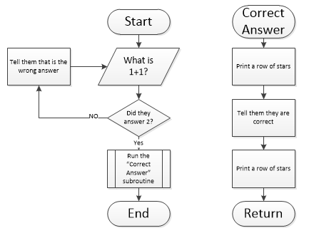
Flowchart
Shows the logic of the program (not the code!)
Start, End, Return, Process, Input, Decision, and Subroutine boxes
Variables not generally included (other than counters)
Create using MS Visio or www.draw.io
Notes:
No code included – it is a visual representation of the logic of the program
Uses the boxes listed. Classes are defined differently which we’ll cover on the upcoming slides.
The image shows a flowchart which uses all of the boxes. Refer to Worksheet 7 – Planning on Moodle for a refresher for which boxes are which.
Other than counters, variables aren’t included in the flowcharts. They are instead included in a variable table.
MS Visio and Draw.io are both effective flowcharting tools. Draw.io is a free web based flowcharting interface if you don’t have Visio installed.

Slide 5
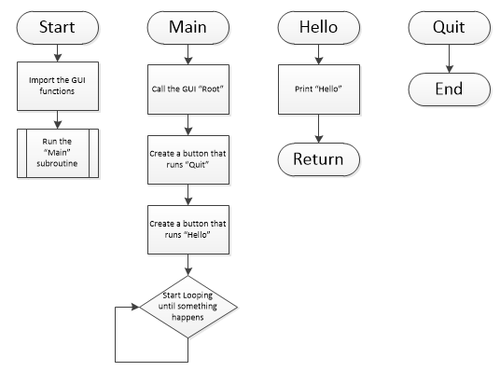
Flowcharts and GUIs
Program “Start” commonly imports GUI then runs “Main” subroutine
“End” is usually grouped with a Quit button
Main usually closes with a loop – this is root.mainloop( in action
Notes:
When the program starts, all it does is import the GUI and run the “Main” subroutine. This is good practice.
There is no “End” to the “Start” section of the flowchart - this is because the program never ends here in this initial part.
- The “Quit” button ends the program, which is why the “End” is grouped with it.
The “Main” subroutine finishes with a loop. This is because once “Main” has set up the environment, it just waits until a button is clicked or something else happens (this is the function of the root.mainloop() line of code).

Slide 6
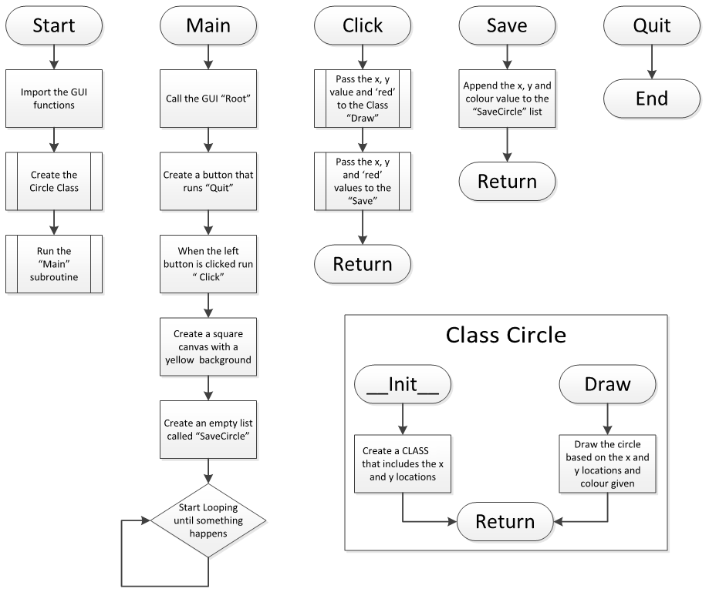
Flowcharts and Classes
Classes are put in a ‘container’ on the flowchart
Use the subroutine box if passing values to a class method
Notes:
When the program starts, all it does is import the GUI and run the “Main” subroutine. This is good practice.
There is no “End” to the “Start” section of the flowchart - this is because the program never ends here in this initial part.
- The “Quit” button ends the program, which is why the “End” is grouped with it.
The “Main” subroutine finishes with a loop. This is because once “Main” has set up the environment, it just waits until a button is clicked or something else happens (this is the function of the root.mainloop() line of code).

Slide 7
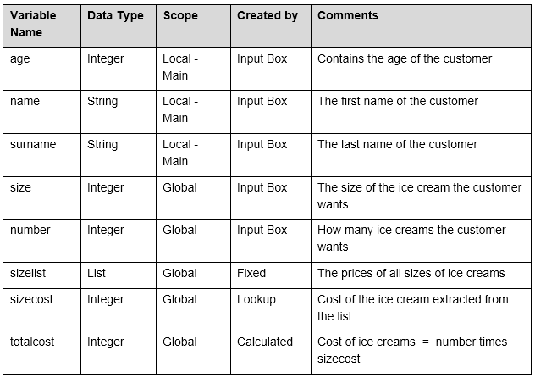
Variable table
Shows all of the variables that will be included in the program
Details include name, data type, scope, created by, and comments
Must be accurate
Notes:
Variable Name: This is the name you assign the variable - it must be a sensible name
Data Type: The type of data such as integer, string, list, etc.
Scope: Whether the variable is local or global - if local the subroutine it is used in must be named. If there are no subroutines this column is not needed
Created By: Variables can get their content from direct input, calculations, looking up a list etc.
Comments: An explanation of what the variable is for in the program
Important! Many languages have case sensitive variable names so don’t allow Word to capitalise the first letter for you when typing in your variable names.

Slide 8
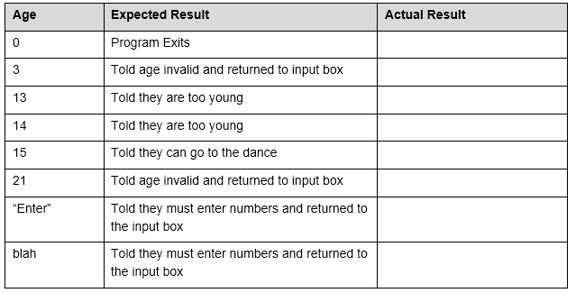
Testing table
Tests expected, boundary, and unexpected values
Columns include variable to be tested, expected result, and actual result
For higher than Achieved, it must be possible for boundary and unexpected values to be entered
Notes:
Expected Input: Input values that fall safely within the range of values we might expect. For example, entering 23 and 75 if asked to enter values between 0 or 100.
Boundary Cases: Values that are right on the edge of what the program is programmed to accept. For example, entering 0 or 100 if asked to enter a value between 0 or 100.
Unexpected Inputs: Values outside the range of what the program is created to accept. For example, entering A, -1, or $ if asked to enter a value between 0 or 100.
Detail is important when creating testing tables.
Note that the testing table is not actually completed until the program is written, at which point the Actual Result column is filled out

Slide 9
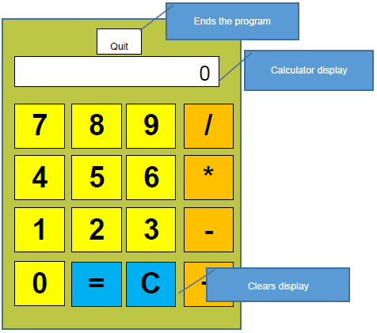
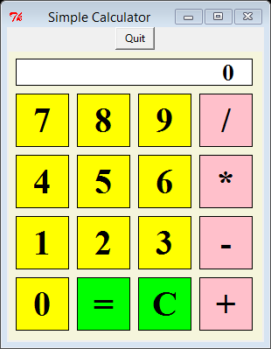
Design sketch
Sketch Program
Note that this missing a lot of detail!
Notes:
You must provide a drawing (created either on the computer or by hand) which shows how the intended program will look, and the function of each aspect of the design.
The example shown above is far from done in terms of detailing the functions of each aspect of the design.
If you prefer, you could provide a drawing, then a bullet point list of all the functions of the aspects of the design. Just make sure that it is clear.

Slide 10
Assessment requirements
Your flowchart doesn’t have to be perfect, but it must appear to be correct before approval
The flowchart must be modular (make use of subroutines)
Event handling is what will happen when you click or enter something, and should be accounted for on the flowchart and testing table
Documentation must be comprehensive. If something isn’t clear, write a paragraph to explain it
Check out pages 23 + 24 of Worksheet 7 for some assessment planning tips
Notes:
Flowcharts don’t have to be perfect before they are signed off as it’s very difficult to create the ‘perfect’ flowchart. However they must be as good as possible before they will be approved. Remember you cannot get higher than Achieved if you don’t get your plan approved before you begin your programming (as if you don’t, you cannot said to have been following a structured development process).
Make use of subroutines in your flowchart
Account for event handling in your flowchart and testing table (event handling is what happens when you click or enter something)
If you’re not sure how much documentation to do, err on the side of being more detailed than less detailed. If you feel anything about your plan, program, or testing isn’t clear, then write a paragraph to explain it.
Remember to update your plan once your code is complete if necessary.

Slide 11
Today
Begin working through Worksheet 7 – Planning
Decided what program you will create for the assessment?
Run it by us
Notes:
Complete Worksheet 7
If you have decided what program you will create for the assessment, let us know. If you haven’t, get your thinking cap on because you need to complete your plan for it!

Slide 12
Homework
Complete Worksheet 7 - Planning
Complete your program plan (flowchart, variable table, testing table, and design sketch) ready for approval
By next class
Notes:
Complete worksheet 7 for homework
Complete your assessment flowchart, variable table, testing table, and design sketch
By next class is not a hard deadline, but you will want to complete your planning as soon as possible to leave yourself enough time to create your program and properly test it

Slide 13
Next class
August 4
Imagitech Theatre
Note: 4 more classes to go!
Assessment due at the end of the module
Notes:
Next class on August 4 in Imagitech Theatre
Only 4 classes left.
Assessment due at the end of the module.

